Slide 1
Team 6
Haotian Zhang, Souvik Dey, Siddhesh Pawar, Galekwan Sango

Slide 2

AWS Rekognition Template
Our project is a security application that captures video frames off of a live video stream and compares them against a dataset of criminals pictures for detection. And returns an alert when detection occurs

Slide 3

Overview
Imagine having the ability to capture real-time video streams, recognize objects through deep learning, and then initiate actions or notifications based on the identified objects.
This is precisely what our project, built on AWS, aims to help you achieve.
The prototype was specifically designed to address a particular use case: alerting based on a live video feed from an IP security camera. At a high level, the solution operates as follows: a camera monitors a designated area, streaming video across the network to a video capture client. The client samples video frames and transmits them to AWS, where they undergo analysis and are stored alongside metadata. If certain objects are identified in the analyzed video frames, SMS alerts are dispatched. Upon receiving an SMS alert, individuals may want to understand the cause, and for this, sampled video frames can be promptly monitored through a web-based user interface with low latency.

Slide 4

Aws Technologies

Slide 5
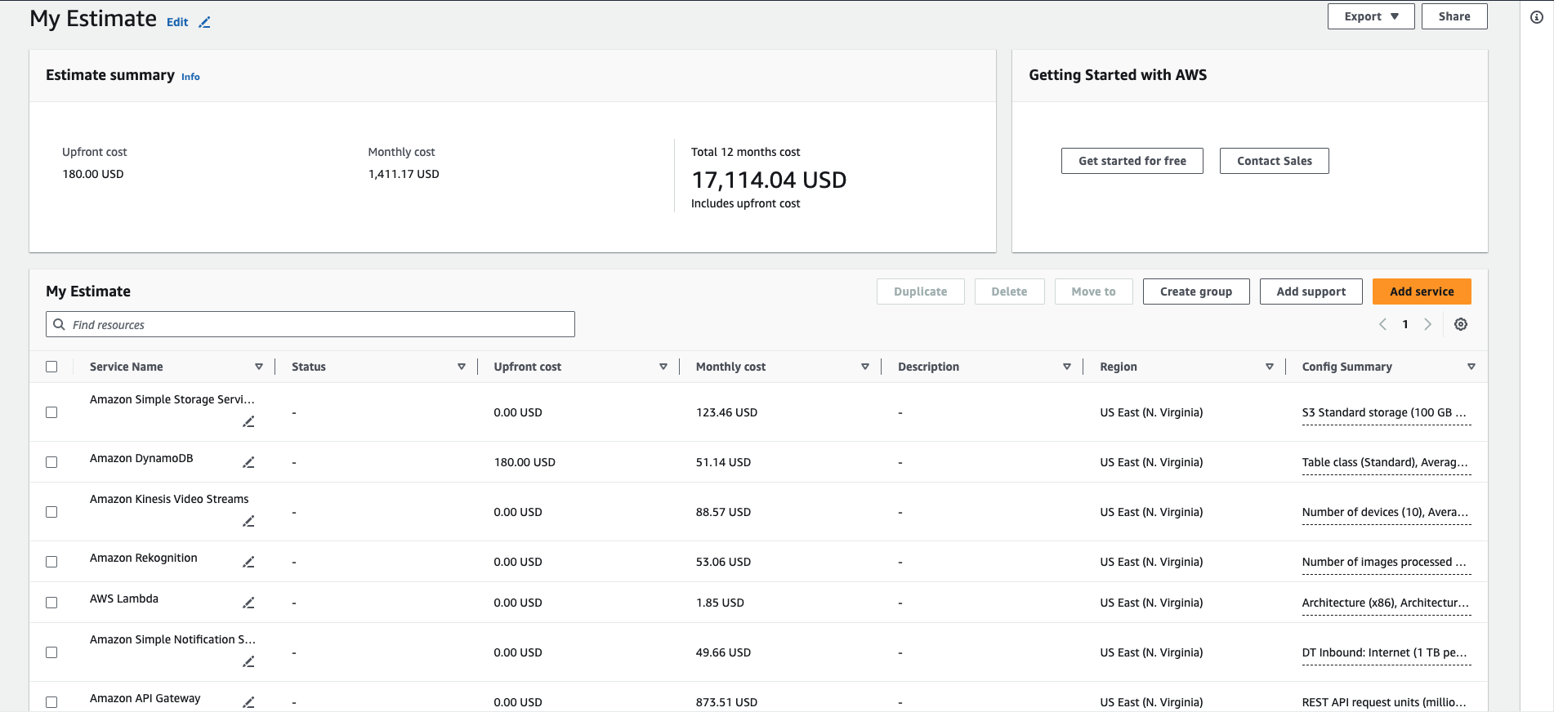
Cost Estimate for small to medium store

Slide 6
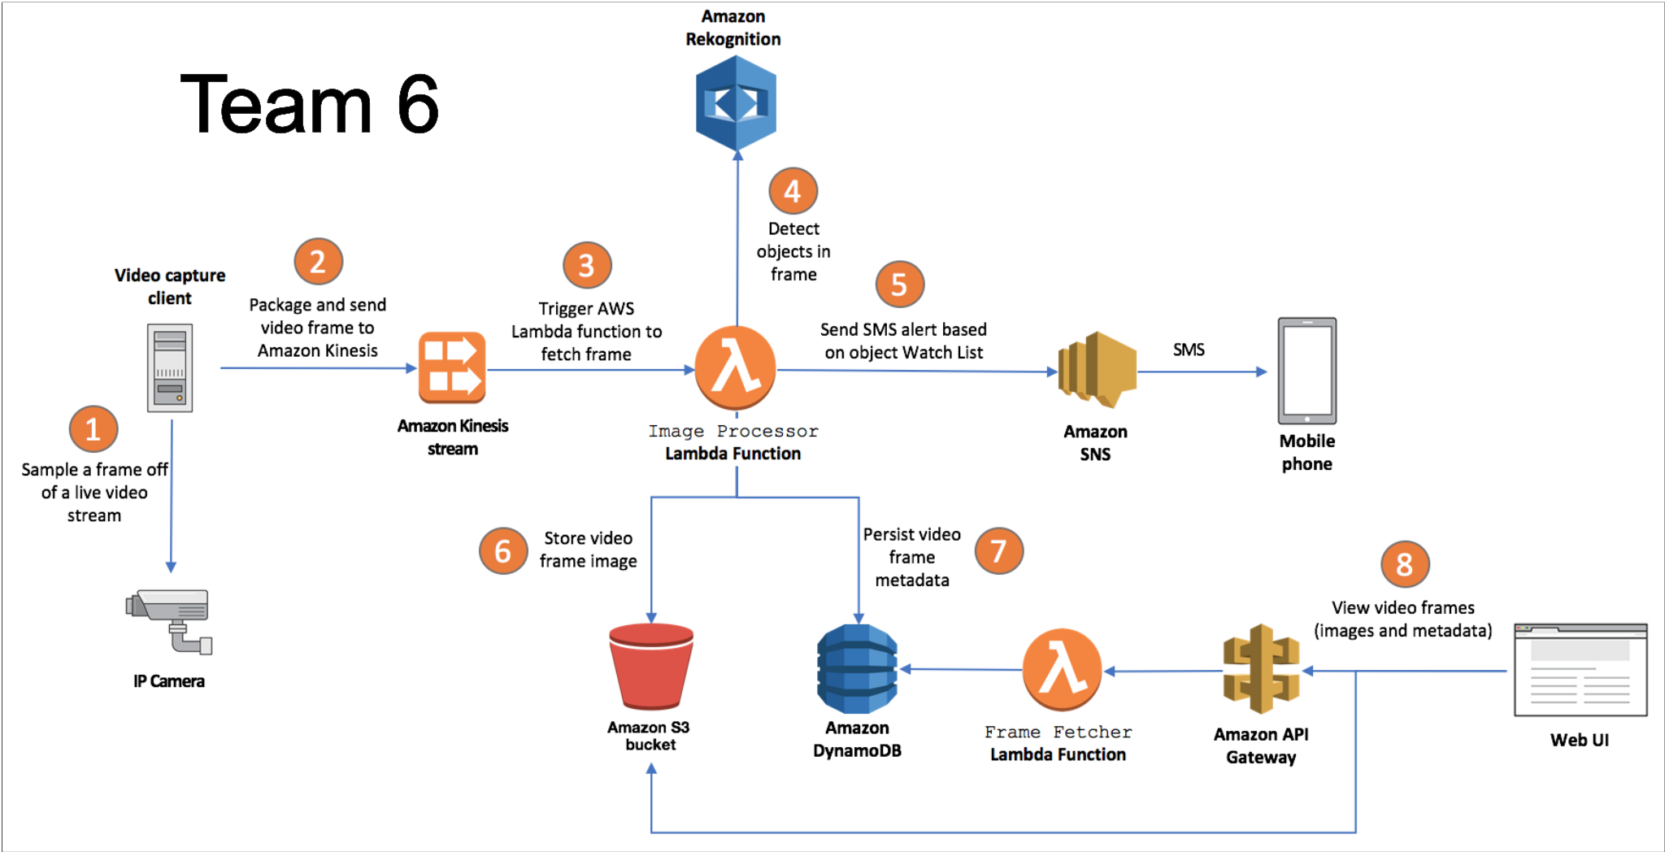
High-level data flow diagram

